Slide 1
Institute of Robotics and Intelligent Systems
Basic Introduction

Slide 2
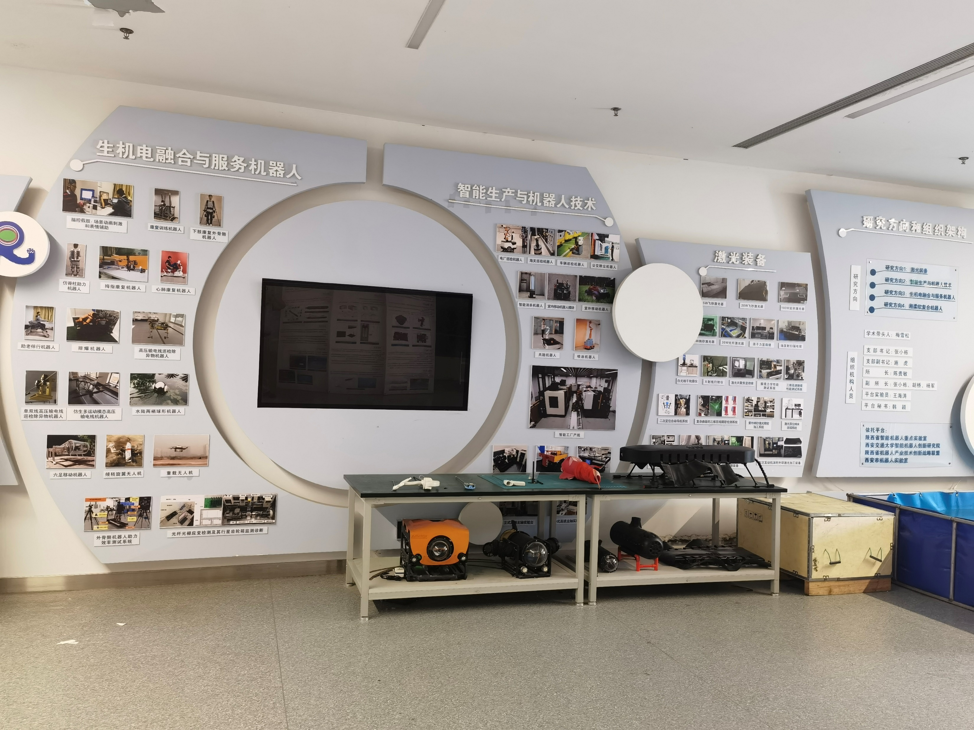
Institute of Robotics and Intelligent Systems includes the four innovational research groups as follows.
Laser processing and equipment
Intelligent production and robotics technology
Biomechatronics integration and service robots
Rigid flexible composite robot technology
Reception Hall for Institute of Robotics and Intelligent Systems

Slide 3
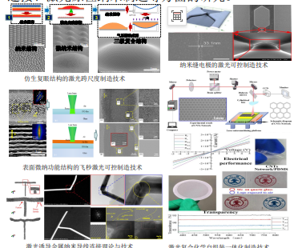
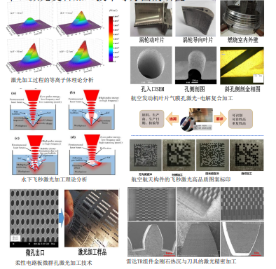
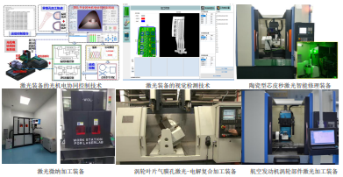
Laser processing and equipment

Slide 4
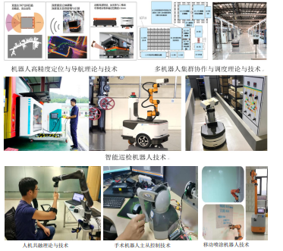
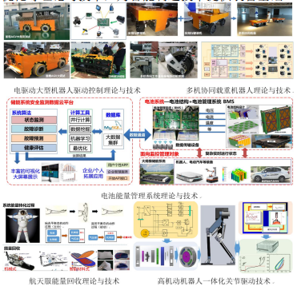
Intelligent production and robotics technology

Slide 5
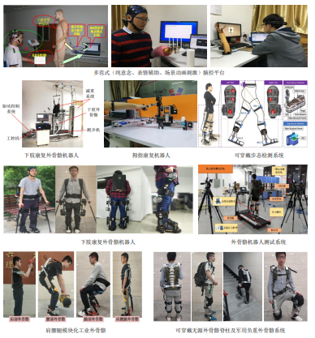
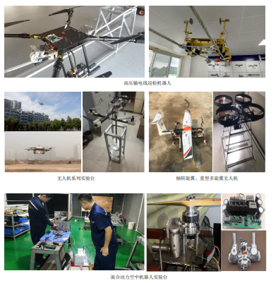
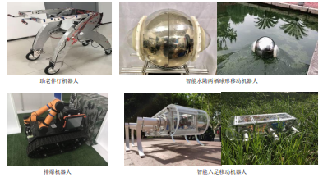
Biomechatronics integration and service robots

Slide 6
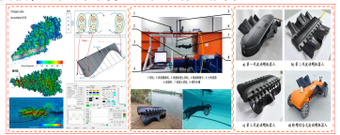
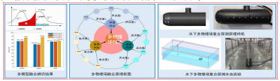
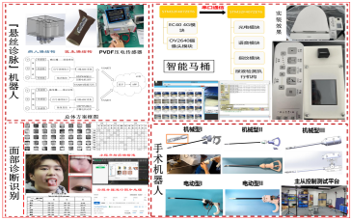
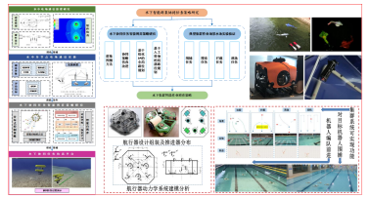
Rigid flexible composite robot technology

